Slide 1

BLOCKCHAIN
INTEGRATED
TOKEN BASED VOTING SYSTEM
RAJDEEP PAL
SUBHADIP MONDAL
SOHAM DE
SHAUNAK GHOSH

Slide 2


Table Of Contents
01.
Introduction
02.
Our Project
03.
About Us

Slide 3


01.
Introduction
Our project addresses the challenges of decentralized dispute resolution by developing an optimized token-based arbitration system. Leveraging blockchain technology, we aim to create a fair, transparent, and efficient platform where jurors self-select by staking tokens, with selection likelihood based on their stake. Our solution tackles key issues such as preventing token monopolization, resisting Sybil attacks, and aligning incentives for honest decision-making. By combining dynamic token mechanics, randomized juror pools, and a user-friendly interface, we ensure a secure and scalable arbitration process for decentralized platforms."

Slide 4


Welcome
To Presentation

Slide 5


Our Project
Blockchain Integrated Token Based Voting System
Your project focuses on building a decentralized arbitration system designed to optimize token-based dispute resolution on blockchain platforms. It addresses key challenges such as efficient juror selection, fair participation, prevention of token monopolization, and resistance to Sybil attacks. By using a token-staking mechanism, dynamic token pricing, and randomized juror pools, the system ensures that engaged participants are fairly selected, while also aligning incentives for honest decision-making through a reward and penalty structure. The goal is to create a secure, scalable, and user-friendly arbitration process that enhances trust in decentralized platforms.
YEAR: 2024

Slide 6

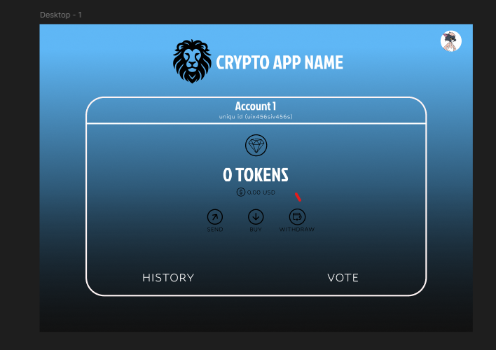
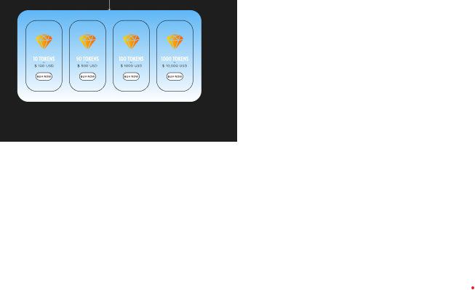
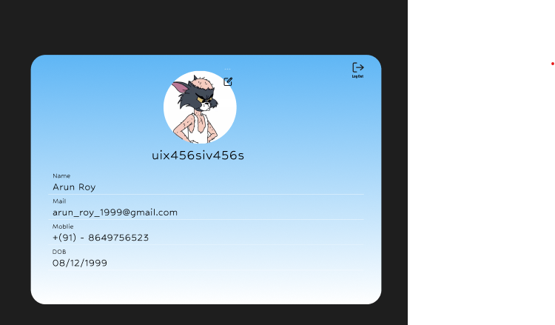
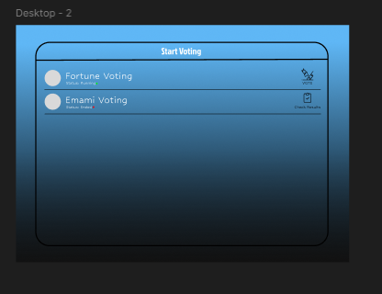
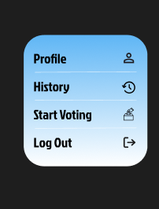
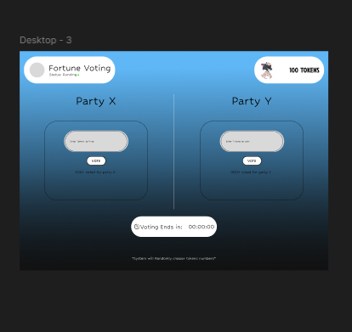
Image Gallery
What can you say about your projects?
Share it here!

Slide 7

More about our Project
Our project integrates a decentralized arbitration system with blockchain technology, ensuring a highly secure and private dispute resolution process. Users can participate without revealing personal information, as the system assigns a unique ID for transactions and interactions. This approach protects user anonymity while maintaining transparency and trust in the arbitration process. By leveraging blockchain's security features and innovative token-based mechanics, we deliver a fair and efficient solution for resolving disputes on decentralized platforms.

Slide 8


03.
About Us
We are a team of four college students passionate about blockchain technology and decentralized solutions. Together, we’re building a secure and private arbitration system that integrates with blockchain, enabling anonymous dispute resolution through unique IDs and token-based mechanics. Our goal is to enhance trust and fairness in decentralized platforms.

Slide 9

Team Members
Rajdeep Pal
Soham De
Leader | Coder | Designer
Team Member | Designer
Subhadip Mondal
Shaunak Ghosh
Team Member | Coder
Team Member | Coder

Slide 10
Thank You Very Much
our Figma Design - https://www.figma.com/design/4GBpqKTjt4orJNQw0LAWV9/crptotokensystem?node-id=0-1&t=0oIuYiEq2Q2sFUMU-1

